Slide 1
Welcome Capstone Project – 1 EDA ON : Hotel Booking Analysis Present By : Bhagyashri Ramesh Dhavale.

Slide 2
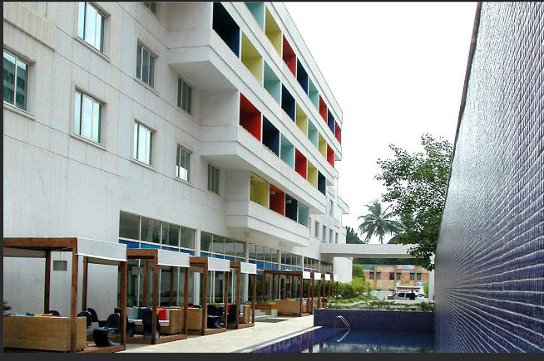
Legends
Hotel Selection Aanalysis
Based on facility.
Summary Data.
Market Aanalysis.
Booking cancellations .
Challenges .
Conclusion .
Summary .

Slide 3
I. Hotel Selection Aanalysis
Based on Categories.
City Hotel.
Resort Hotel.

Slide 4
Continue...
Based Categories.
Tourism
Adults
Children
Official
Business person

Slide 5
Based On Facilities.
Purpose Of Visit :: A. Official B. Tour/Spiritual
Based On Area / Location .
Car Parking – Sufficient space with good car parker / driver availability.

Slide 6
II. Summary Data.
Types Of Hotel
City Hotel
Resort Hotel
Food
Veg / Non-veg
Dinner
Drinks – Soft &Hard
Refreshment meal

Slide 7
III. Market Segment.
In that we have summarize the purpose of booking , it may be official work / corporate and may be picnic / tourism also.
Timewise analysis – Duration.
Customer type
Bleisure (Business travellers)
Event attendees
Families
Backpackers

Slide 8
IV. Booking /Cancellations
Booking
Maximum :- July to August
Cancellations
I. Sudden changes in plan II.. Minimum work length
Minimum :- November to February
III. Based area / Location IV. facilities

Slide 9
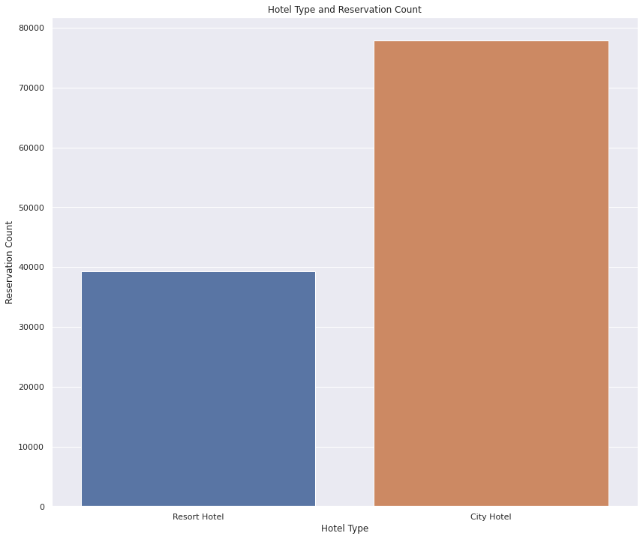
Reservation count :
City hotel has more reservation compared to Resort hotel
City Hotel
Resort

Slide 10
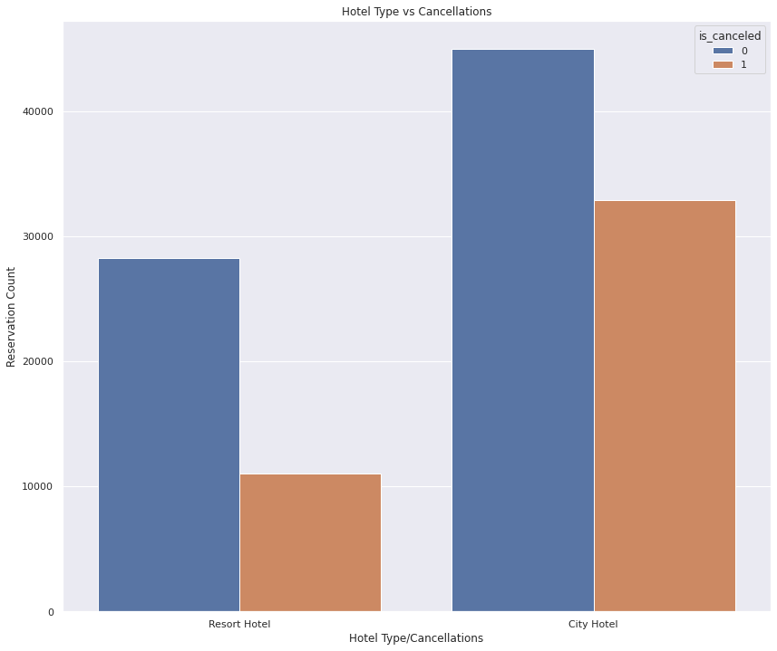
Cancellation count :-
City hotel has more cancellations compare to Resort hotel.

Slide 11
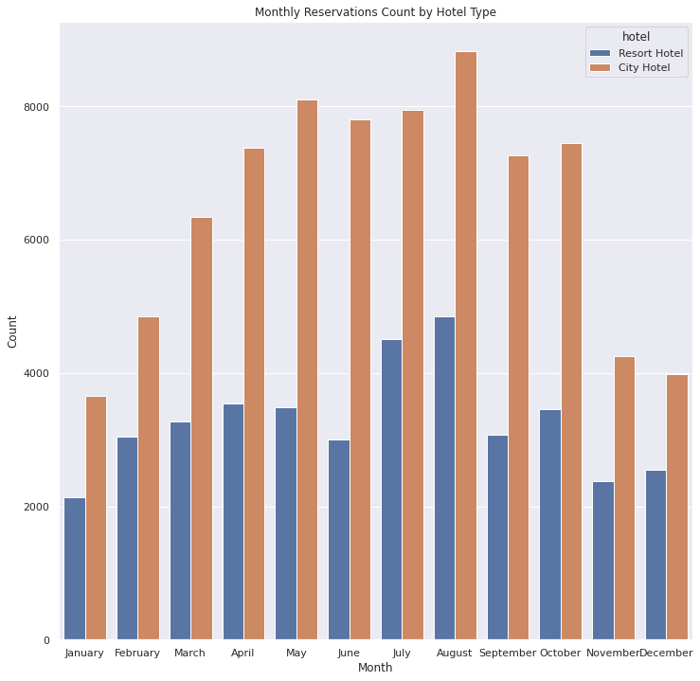
Monthly Reservation Count

Slide 12
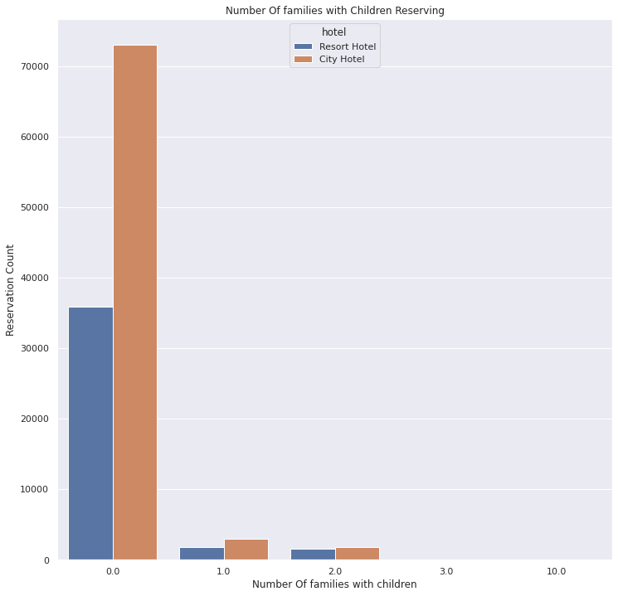
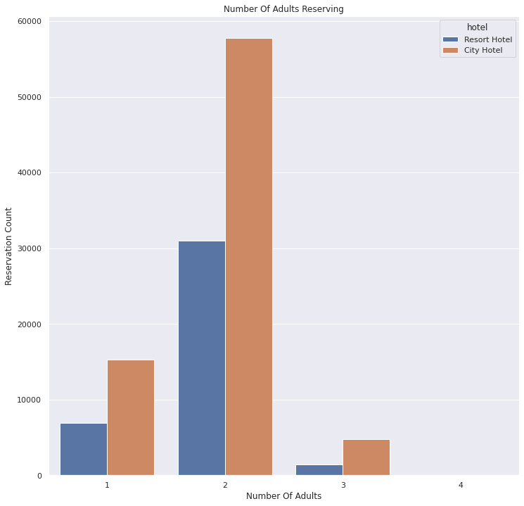
Number of
Adult
Children
Families

Slide 13
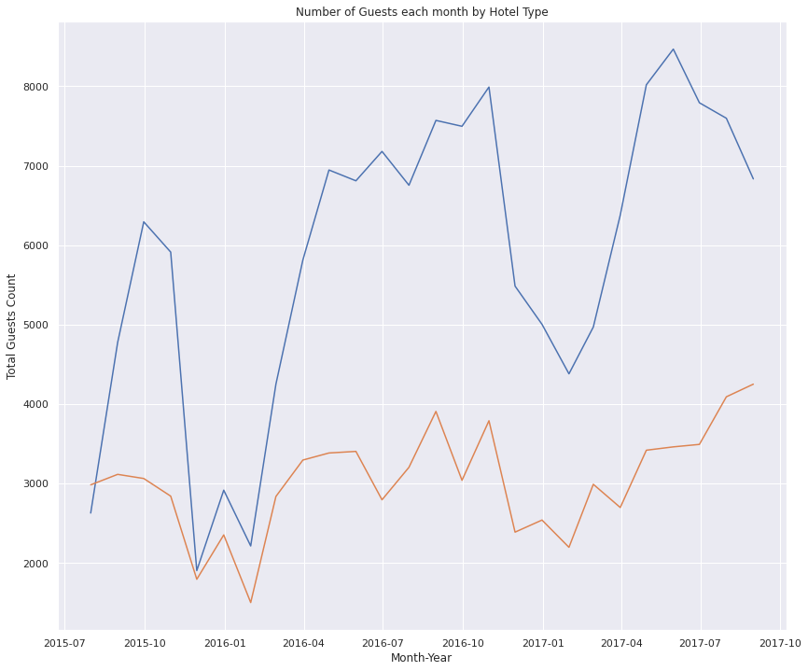
Month wise customer frequency.
Resort Hotel have more quantum as a families compared to city hotel.
wise versa city hotel have more customers/quantum as a single entity resulting more customers with less quantum frequency.

Slide 14
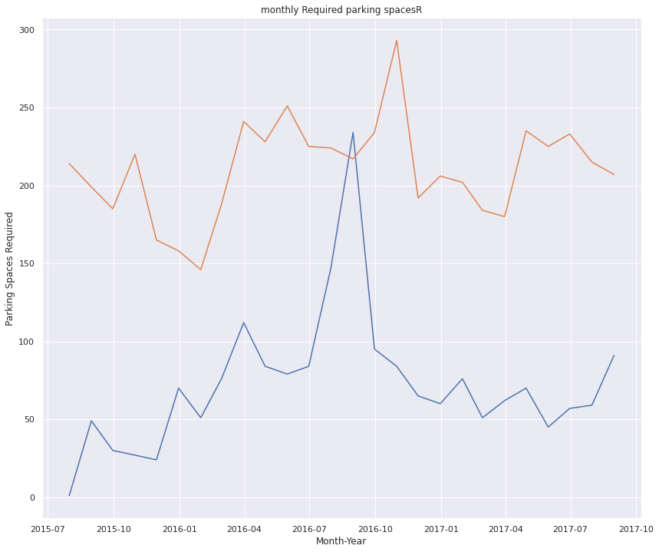
Car parking spaces.
Due to maximum booking City hotel must have more parking spaces compare to resorts.

Slide 15
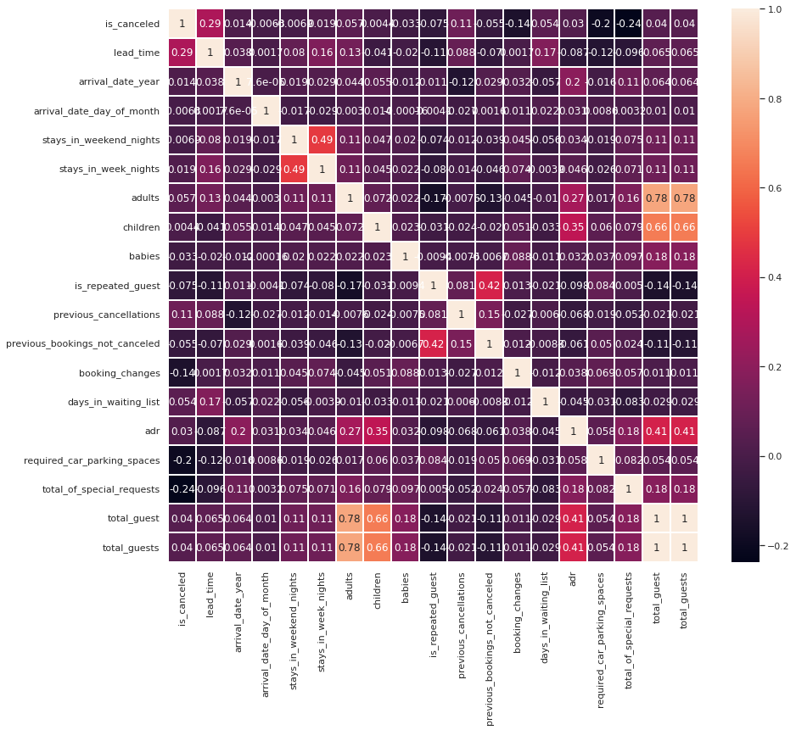
Heatmap.
Lead time and total stay is similar .
Repeated guests are more.
Previous booking not cancelled is similar with repeated guests because not more likely to cancel their bookings.

Slide 16
V . Challenges.
Huge chunk of data was to be handled keeping in mind not to miss anything which is even of little relevance.
Computation time.
Feature selection quite challenges.

Slide 17
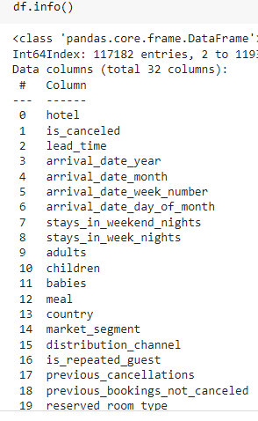
VI . Conclusion
This project contains the data records of city hotel and resort hotel details like booking , cancellations guests details etc. From 2015 to 2017.
1) City hotel has more reservation than resort hotel.
2) City hotel has more cancellations compared to resort hotel.

Slide 18
Continue....
3) Resort hotels are choice for large groups / families.
4) City hotel has more guests in August and resort hotel also has more guests in August. 5) High business - March to October
6) Low business - November to January.

Slide 19
Continue....
7) More number of people in guests results in more number of special requests.
8) In 2016 city hotel parking reached 300 and resort hotel has surge parking.

Slide 20
THANK YOU...

